Slide 1
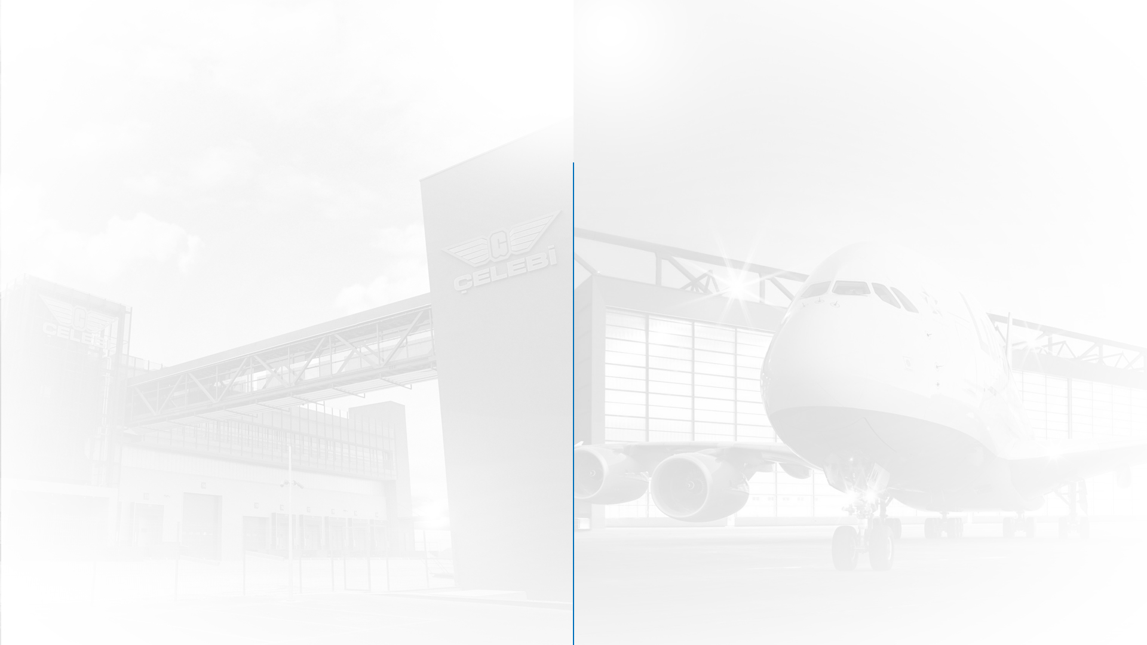

BAŞLIK
BAŞLIK

Slide 2

Başlık

Slide 3




Başlık

Slide 4

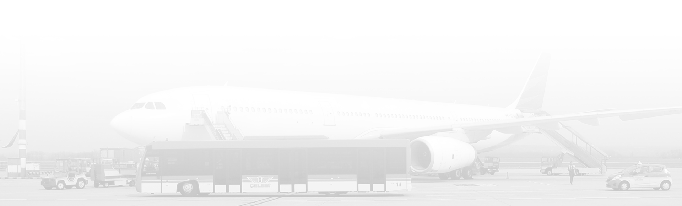
Başlık

Slide 5

Başlık
Load Control
& Flight Operations
The procedure of balance calculation
is performed by well-educated
operation officers.
The experts calculate on basis of the number of passengers, the loaded baggage and goods, the refueled kerosene and location of the aforesaid to identify where exactly the center of gravity of the aircraft is. It is essential for the safety of the flight and to the realization of the lowest possible fuel consumption.

Slide 6


Başlık

Slide 7


ARA
BAŞLIK

Slide 8
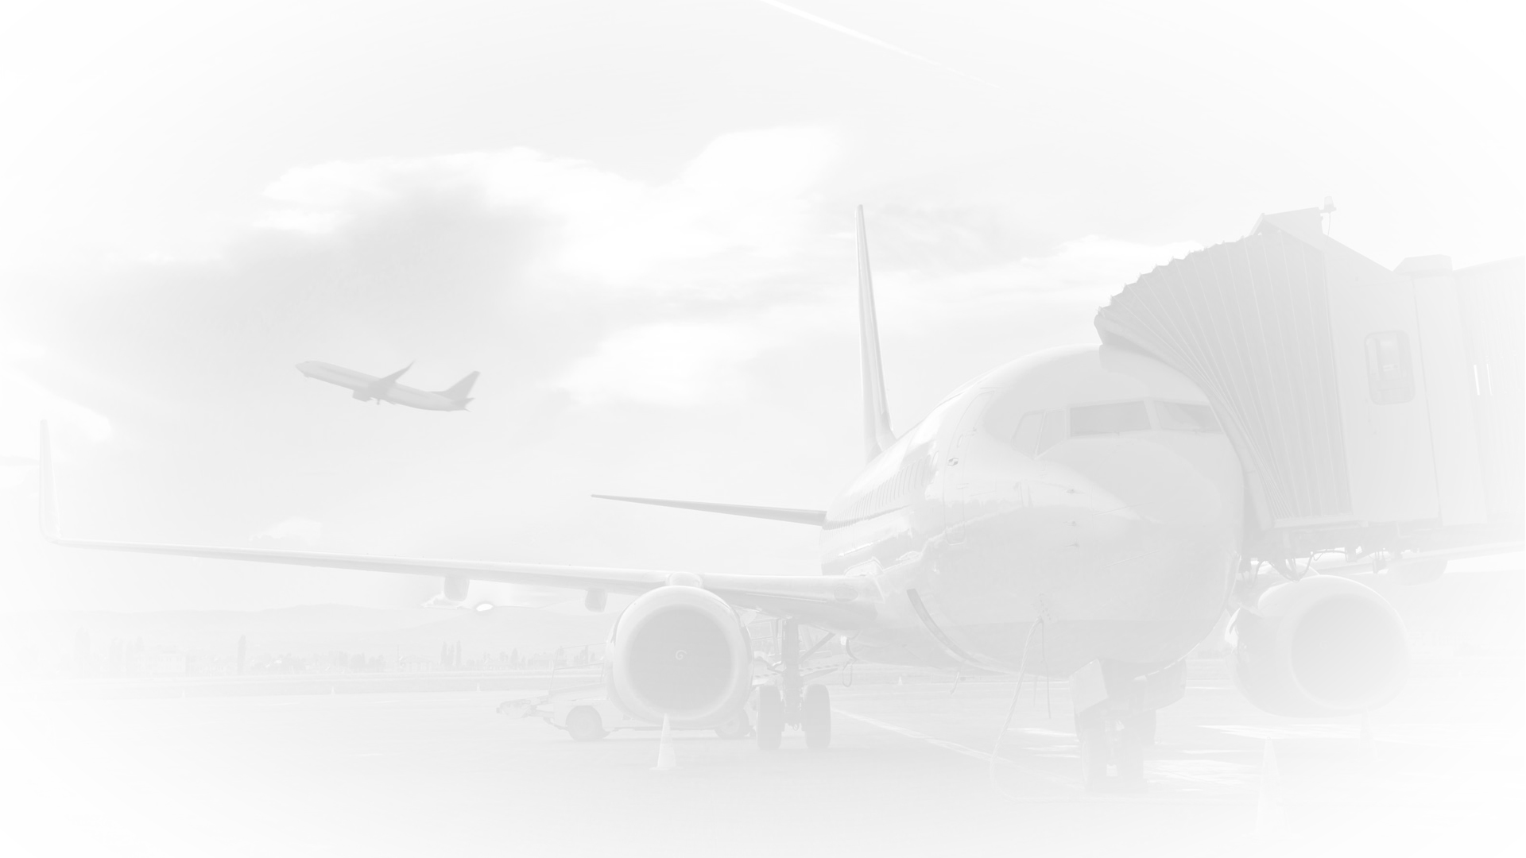




TEŞEKKÜRLER!
celebiaviation
celebiaviation
celebiaviation

